Slide 1





Fed-BioMed:
A Federated Learning Software Framework
for Collaborative IA
Marco Lorenzi
Inria Sophia Antipolis, Université Côte d’Azur
Epione Research Group

Slide 2

Big Data in medicine
Single hospital: 100s – 1’000s patients
Data from many hospitals needed
Access to multiple centers data
falls into General Data Protection Regulation (GDPR):
Privacy, confidentiality, security, ...
Data cannot be gathered in a single centre!
Standard learning algorithms cannot be used in multicentric data

Slide 3




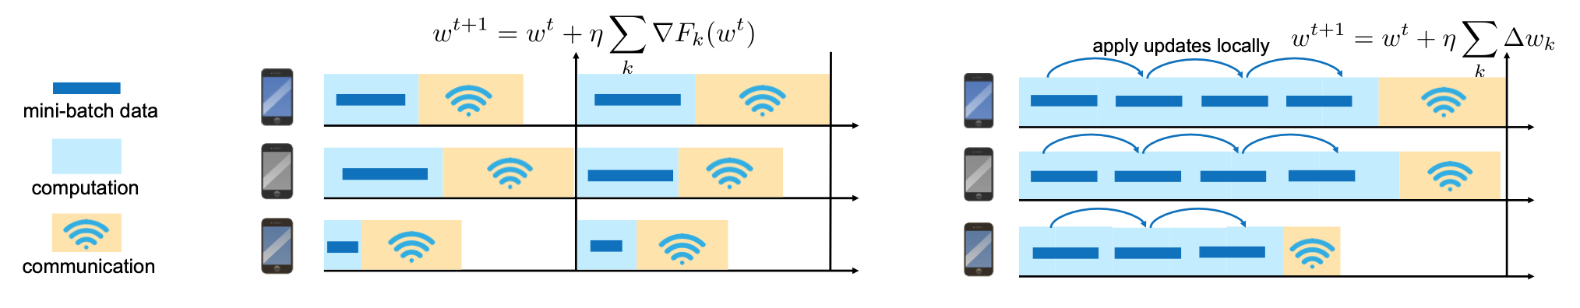
The rise of Federated Learning
clients
federator
Decentralized training paradigm for models optimized through stochastic gradient descent (e.g. neural networks)
Li, T., et al (2020). IEEE Signal Processing Magazine, 37(3), 50-60.

Slide 4
The rise of Federated Learning
clients
federator
Decentralized training paradigm for models optimized through stochastic gradient descent
Li, T., et al (2020). IEEE Signal Processing Magazine, 37(3), 50-60.

Slide 5
The rise of Federated Learning
clients
federator
Local model’s parameters are shared and aggregated by the federator
Decentralized training paradigm for models optimized through stochastic gradient descent
Li, T., et al (2020). IEEE Signal Processing Magazine, 37(3), 50-60.

Slide 6
The rise of Federated Learning
clients
federator
Local model’s parameters are shared and aggregated by the federator
Decentralized training paradigm for models optimized through stochastic gradient descent
Li, T., et al (2020). IEEE Signal Processing Magazine, 37(3), 50-60.

Slide 7
The rise of Federated Learning
clients
federator
Local model’s parameters are shared and aggregated by the federator
Decentralized training paradigm for models optimized through stochastic gradient descent
Li, T., et al (2020). IEEE Signal Processing Magazine, 37(3), 50-60.

Slide 8
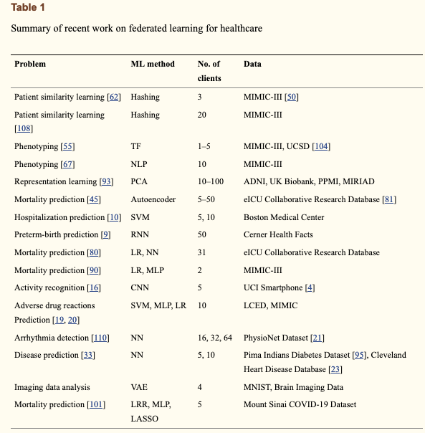
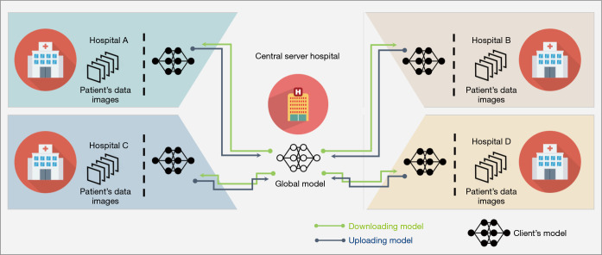
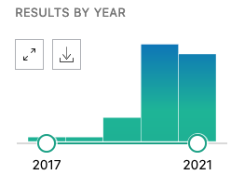
Federated Learning for Collaborative Data Science
From Xu et al. J Healthc Inform Res. 2020
From Ng et al, Quant Imaging Med Surg, 2021;
PubMed query “federated learning” June 6th 2021
Rieke et al. NPJ Digit Med. 2020; Xu et al. J Healthc Inform Res. 2020

Slide 9
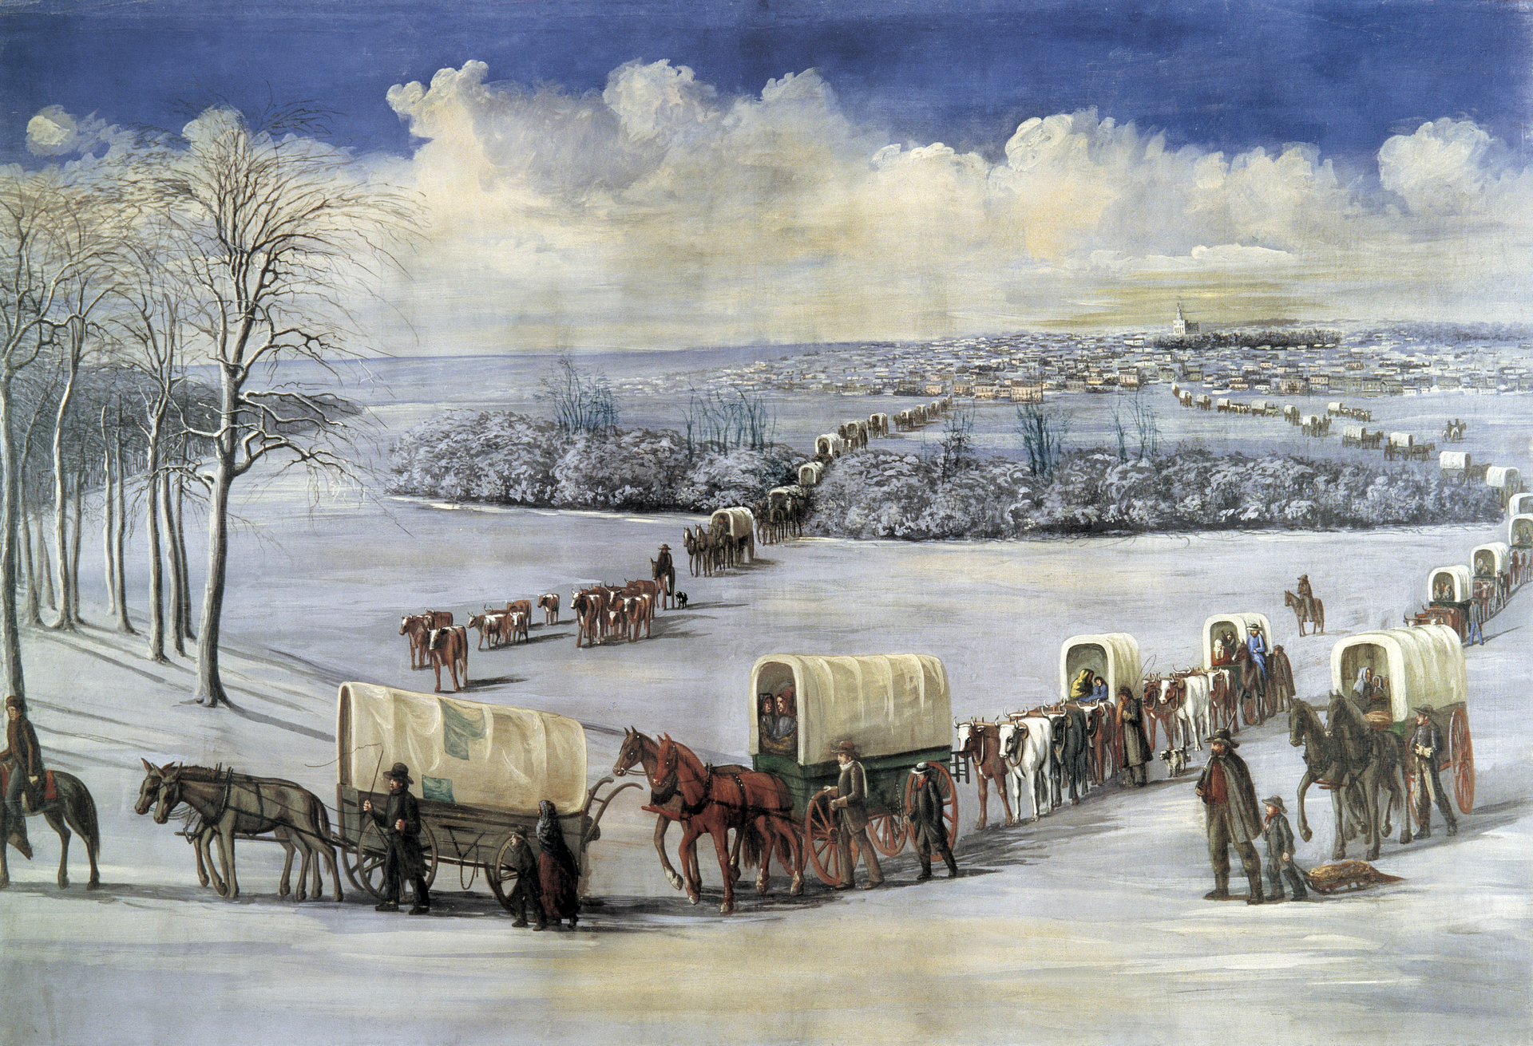





Relevant open initiatives for decentralized learning
The gold-rush of FL
Source:
wikipedia.org/wiki/wild_west
Typical drawbacks
Handling heterogeneous models
Handling heterogeneous training paradigms
Handling heterogeneous clients architectures
Deployment beyond single machine simulation
Server-agnostic clients code
Security in communication and learning
UI
Coinstac
https://coinstac.org/
PySyft
https://github.com/OpenMined/PySyft
Flower
https://flower.dev/
LEAF
https://leaf.cmu.edu/
Tensor Flow Federated
https://www.tensorflow.org/federated

Slide 10


Fed-BioMed v2
An open source framework for federated learning
Santiago Silva
- Python based, optimized for PyTorch
- Currently relying on PySyft functionalities
Simplified development and deployment of modes
Focus on healthcare data analysis
Funded by
Action de Développement Technologique (ADT) Inria
https://fedbiomed.gitlabpages.inria.fr
Silva S., Altmann A., Gutman B. and Lorenzi M., Distributed And Collaborative Learning, 2020

Slide 11
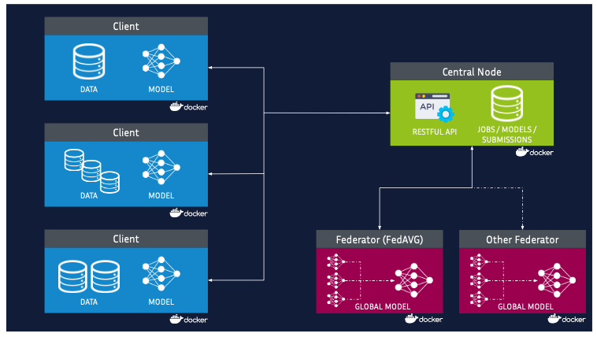
Architecture
Packaged and deployed in form of Docker containers (software/hardware heterogeneity issues)
Reproducibility of pipelines and results
Security in communication and access permissions:
Secured authentication
Communication though dedicated VPN
Silva S., Altmann A., Gutman B. and Lorenzi M., Distributed And Collaborative Learning, 2020

Slide 12
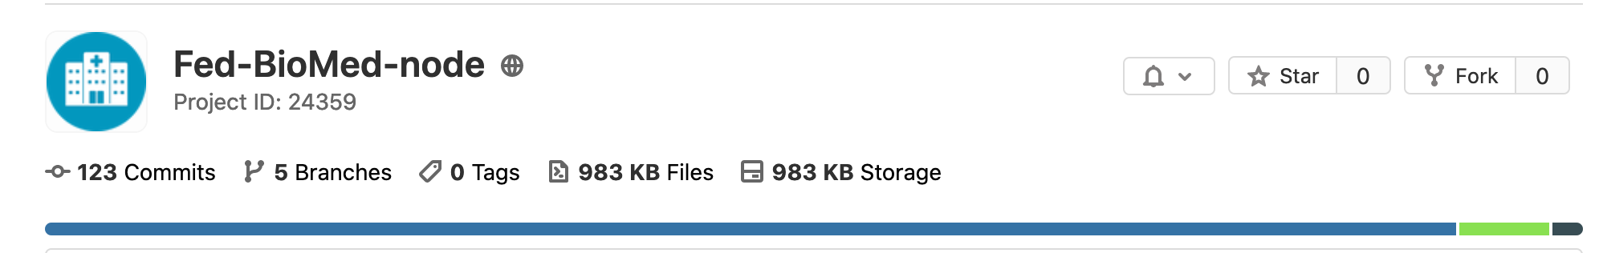

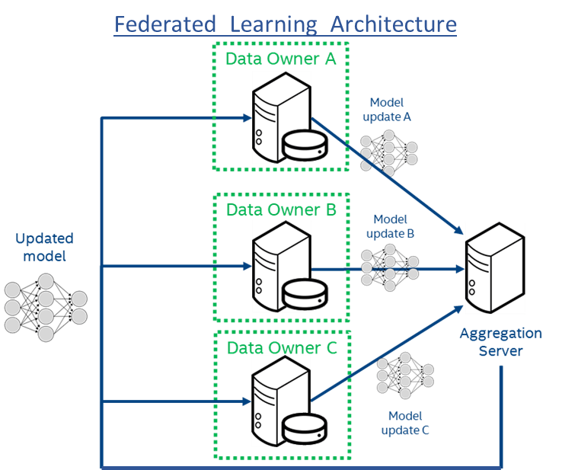

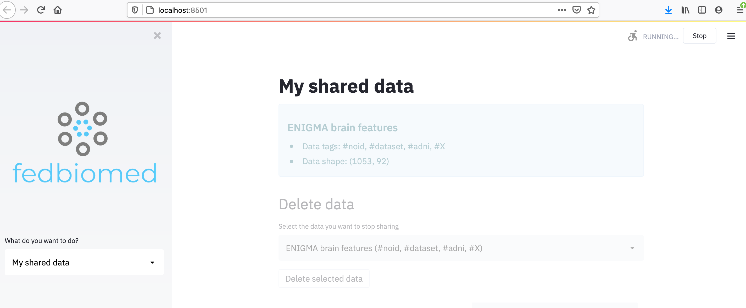
Secured network and authentication protocol
Federated learning network setup
Graphical User Interface via Streamlit
Silva S., Altmann A., Gutman B. and Lorenzi M., Distributed And Collaborative Learning, 2020

Slide 13
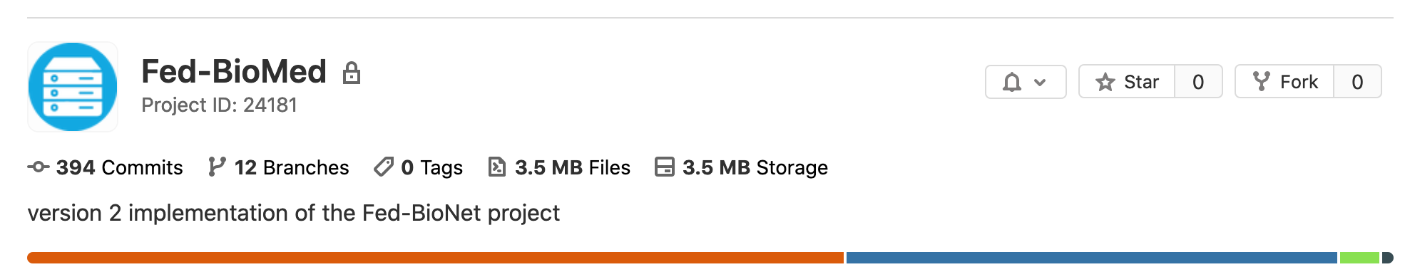
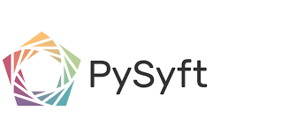
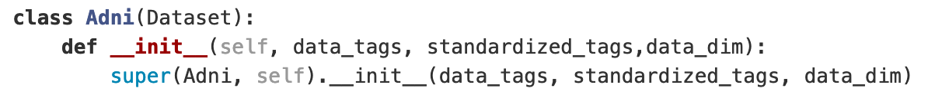
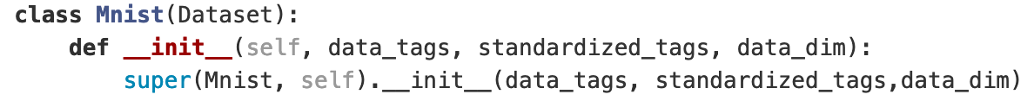
Relying on PySyft for federated training
Implementation of a modular structure for handling different models and datasets
General query data verification format
Specialized data loader for remote clients data pointers
Silva S., Altmann A., Gutman B. and Lorenzi M., Distributed And Collaborative Learning, 2020

Slide 14
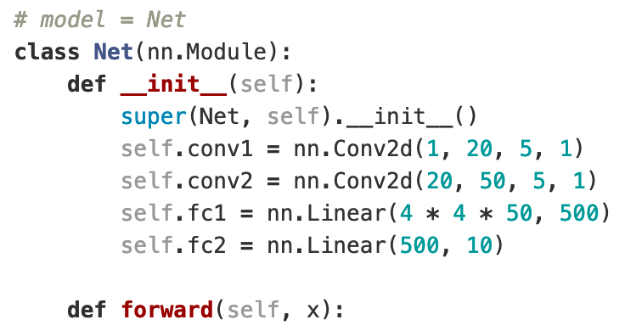
Relying on PySyft for federated training
Implementation of a modular structure for handling different models and datasets
Models are standard Pytorch models defined by the researcher
A worker specifies how training is performed at each client’s side
Silva S., Altmann A., Gutman B. and Lorenzi M., Distributed And Collaborative Learning, 2020

Slide 15
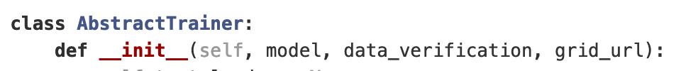
Relying on PySyft for federated training
Implementation of a modular structure for handling different models and datasets
Specializing federated training schemes, aggregation mechanisms, output
Silva S., Altmann A., Gutman B. and Lorenzi M., Distributed And Collaborative Learning, 2020

Slide 16
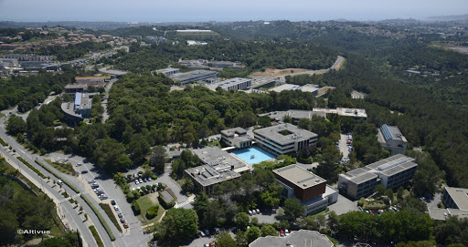
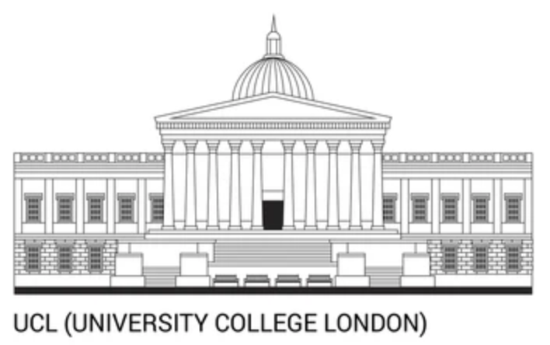
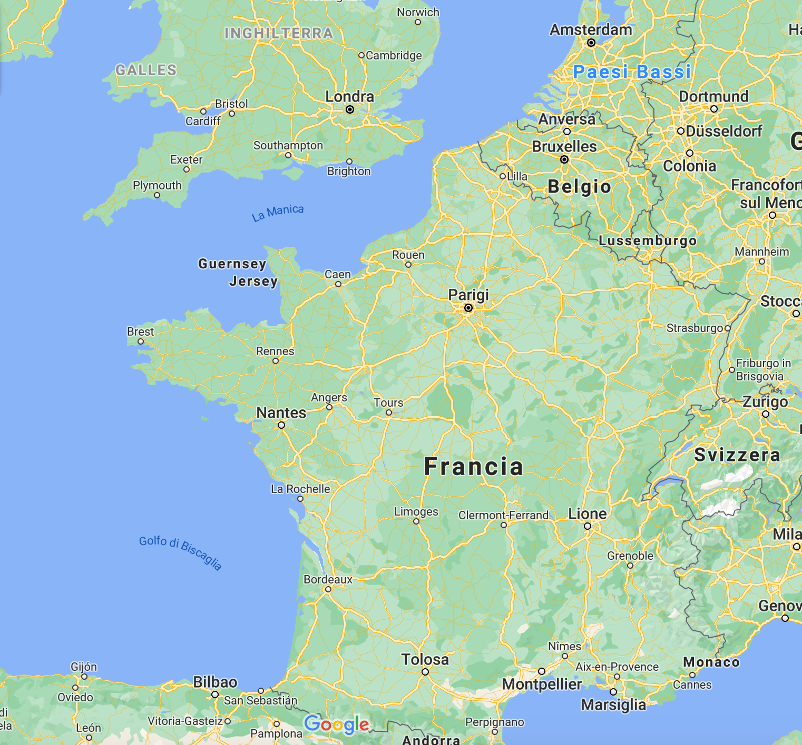


Real experiment with distant sites
The server
Client 1
Dr. Andre Altmann
Centre for medical image computing
UCL London, UK
Inria Sophia Antipolis
Client 2
Application
Analysis of brain imaging data
UKBiobank (1900 individuals)
ADNI (530 individuals)
Federated Training of a
Variational Autoencoder
My laptop (Antibes)

Slide 17
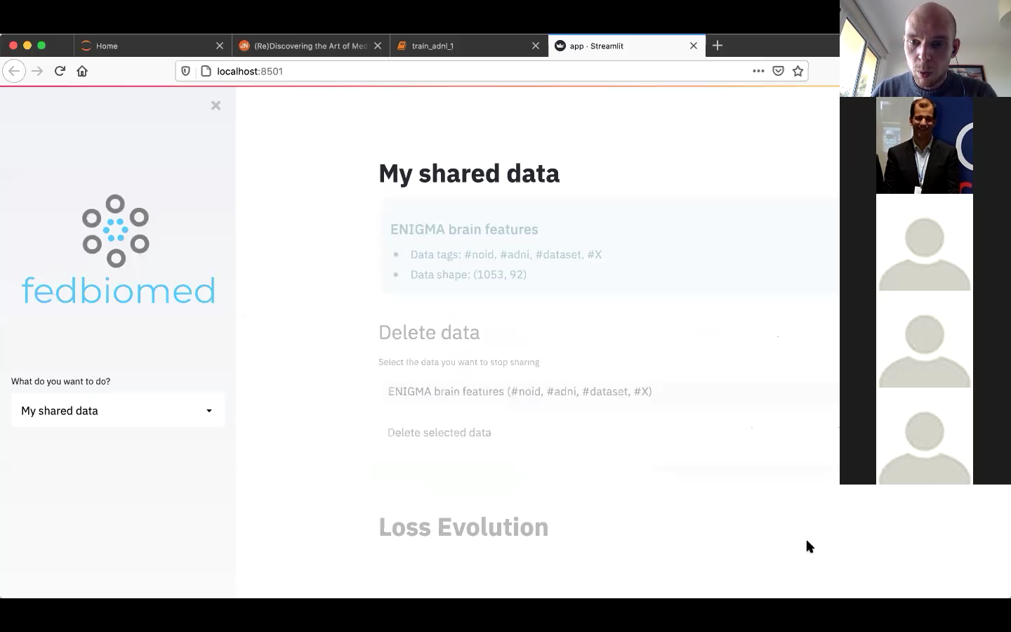
Client
side

Slide 18
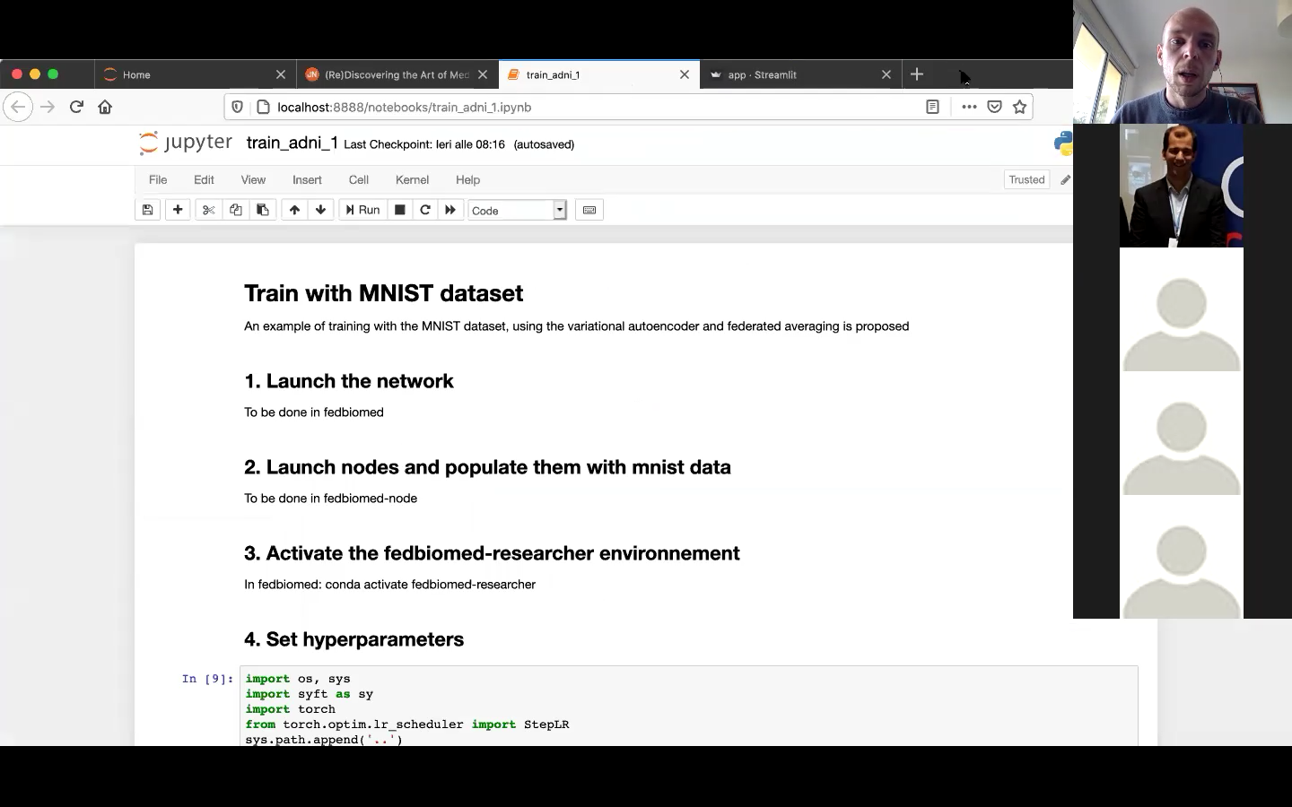
Researcher side

Slide 19
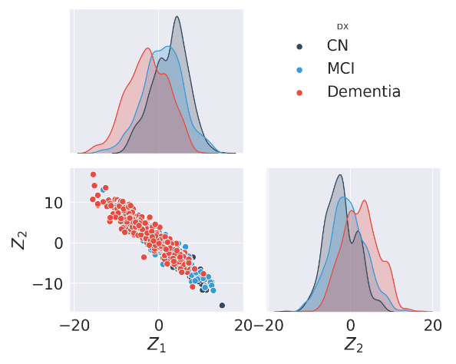
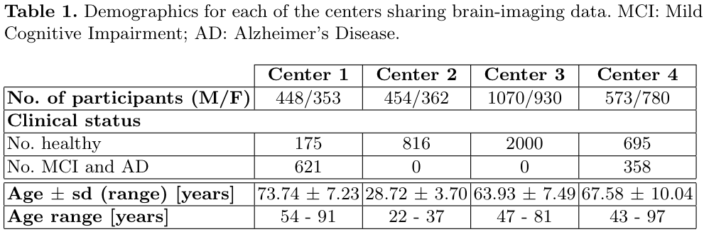
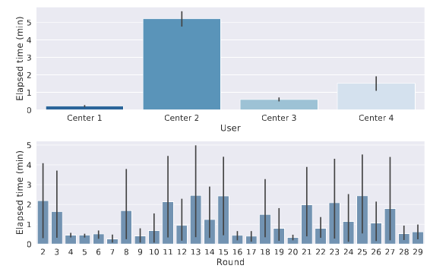
Real world application of FL
Modeling cortical thickness variability across 4 sites
Deep network for variational autoencoder
Latent space
at site France 1
France 1
US
UK
France 2
Optimization
statistics
Silva S., Altmann A., Gutman B. and Lorenzi M., Distributed And Collaborative Learning, 2020

Slide 20

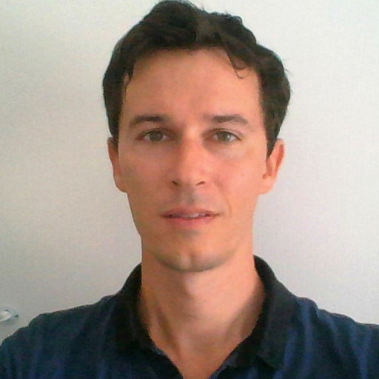

Fed-BioMed v3
Coming soon…
Focus on:
Handling heterogeneous models
Handling heterogeneous training paradigms
Server-agnostic clients code
Security in communication and learning
Funded by
Support from Inria National Plan for Artificial Intelligence
Dedicated development team
Ongoing deployment on Centre Antoine Lacassagne (Nice) and international collaborators (UCL, Stanford)
Contribution from Accenture Labs (Sophia Antipolis)
Olivier Humbert
https://fedbiomed.gitlabpages.inria.fr

Slide 21
Perspectives
FL provides a key framework for modern application of machine learning in sensitive domains
Emerging technology, standards are continuously evolving
Potential for large scale applications of machine learning in collaborative studies
Key issues:
Robustness and bias: Encompassing data across sites and cohorts
Security: Encryption, secured MPC, Attacks (upcoming PhD project funded by 3IA)
Coordination is imperative: Security requirements, authorizations, data standardization,
https://fedbiomed.gitlabpages.inria.fr

Slide 22
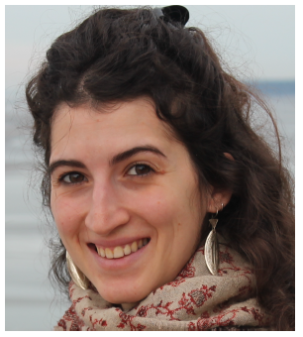
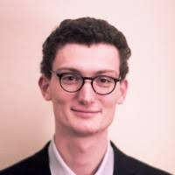
Dev Team
Marc Vesin
Jean-Luc Szpyrka
Tristan Cabel
Maya Assal
Riham Nehmeh
Jonathan Levy
Carlos Zubiaga
Santiago Silva
Irene Balelli
Yann Fraboni
Notes:
explicitly highlight the underlying biology of macroscopic processes, such as brain atrophy, by identifying interacting sets of genes that are jointly associated with the phenotype. Multivariate GWA studies offer the potential to shed light on the complex genotype-phenotype relationship, and may thus highlight novel links between brain physiology and biological as well as molecular functions.

Slide 23
Thank you
Notes:
explicitly highlight the underlying biology of macroscopic processes, such as brain atrophy, by identifying interacting sets of genes that are jointly associated with the phenotype. Multivariate GWA studies offer the potential to shed light on the complex genotype-phenotype relationship, and may thus highlight novel links between brain physiology and biological as well as molecular functions.

