Slide 1


Hacking the AI Layer: Mapping and Exploiting the New Attack Surface
Sergio Loureiro, PhD – VP of Product Strategy
Dec 2025

Slide 2
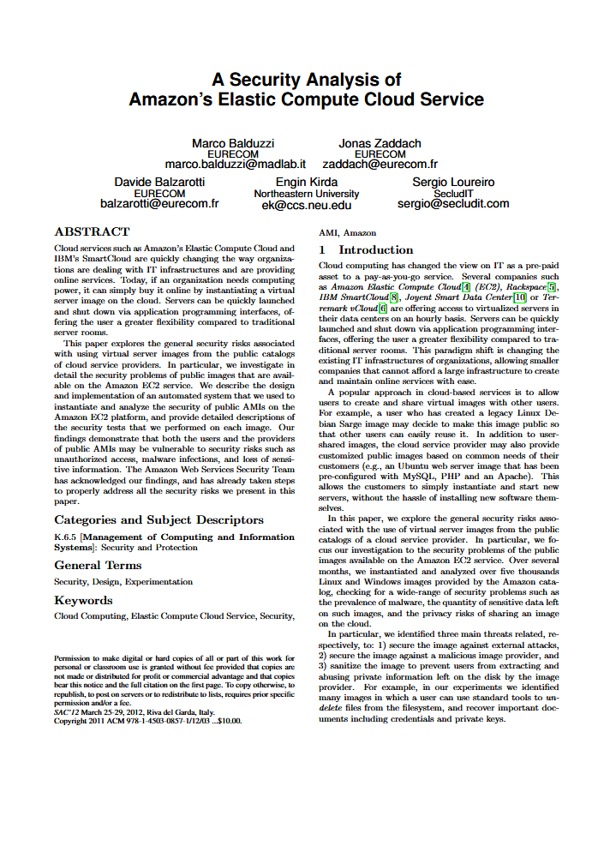
Who am I?
Sergio Loureiro
VP of Product Strategy @ Outpost24
CEO and co-founder @ SecludIT - CSPM
CTO, R&D Director @ security startups (Mailinblack, NS1)
PhD, Network Security @ Telecom Paris
Eng and MSc @ FEUP
https://www.linkedin.com/in/sergioloureiro/

Slide 3







Outpost24 at a Glance
Global cyber security leader, made in Sweden.
Offering proactive and detection-based cyber analytics solutions.
3000+
96%
58
Customers in 80+ countries
Customers reported having a better view of cybersecurity risk after using Outpost24
Fortune 500 companies
2001
8.7M+
100%
Founding year. Experienced.
Here to stay.
Active end users
Customers are satisfied with Outpost24’s ease of use and technical support
Notes:
Outpost24, founded in 2001, is a global leader in cybersecurity. Our mission is to provide proactive and detection-based cyber analytics solutions, enabling organizations to defend against cyber threats and maintain a robust cybersecurity posture.
With over 3500 customers in 65 countries, including 58 Fortune 500 companies, Outpost24 has established itself as a trusted provider in the cybersecurity field.
Our key offerings include comprehensive discovery and visibility, threat intelligence-driven risk prioritization, and continuous penetration testing. These solutions help customers identify and prioritize vulnerabilities, continuously monitor their attack surface, and protect against evolving cyber threats.
Additionally, Outpost24 provides managed services to extend your security operations team, tailored security solutions, and expert-level assessments. We also offer identity and access management solutions, such as compromised password protection and streamlined self-service password reset.
Outpost24 maintains a robust global presence with 14 offices across Europe, North America, and Asia, and is committed to maintaining the highest security standards with 28 active cybersecurity certifications.

Slide 4

The Defender’s Perspective
Agenda
Security Challenges for enterprise using AI
AI Attack Surface
How to minimize exposure to AI?
Handy tools
Playbook for CISOs

Slide 5

Outpost24
97% of organizations reported an AI-related breach and lacked proper AI access controls” – IBM Cost of a Data Breach Report 2025
Notes:
Security incidents involving an organization’s AI remain limited— for now. On average, 13% of organizations reported breaches that involved their AI models or applications. However, among those that did, almost all (97%) lacked proper AI access controls. The most common of these security incidents occurred in the AI supply chain, through compromised apps, APIs or plug-ins. These incidents had a ripple effect: they led to broad data compromise (60%) and operational disruption (31%). The findings suggest AI is emerging as a high-value target.

Slide 6





Outpost24
Breaches with AI Attack Surface
45%
86%
Of AI-generated code contained an OWASP Top 10 vulnerability
Of commercial AI applications tested vulnerable to prompt injection
EchoLeak (Microsoft 365 Copilot)
Veracode 2025
App Threat Report 2025 Q2, Promon
Lenovo “Lena” Chatbot XSS / Session Leakage
48%
Of organizations monitor their production AI systems for accuracy/drift/misuse
Samsung Data Leak via ChatGPT (Employee Misuse)
Kiteworks 2025
Notes:
A zero-click prompt injection vulnerability (CVE-2025-32711) in Microsoft 365 Copilot allowed remote, unauthenticated data exfiltration. Attackers chained multiple bypasses (XPIA, link redaction, auto-fetched images) to escape filters and leak sensitive internal data.
A flaw in Lenovo’s customer support AI chatbot “Lena” enabled attackers to use Cross-Site Scripting (XSS) via crafted prompts to embed HTML/Image payloads, steal session cookies, impersonate support agents, access prior chats, possibly move laterally.
Samsung employees accidentally exposed proprietary or internal code/documents by using ChatGPT to review internal work. Led Samsung to ban employee use of ChatGPT and similar tools across certain units.
IBM - 63% Share of organizations that lacked AI governance policies / 37% Share of organizations that had AI governance policies in place

Slide 7
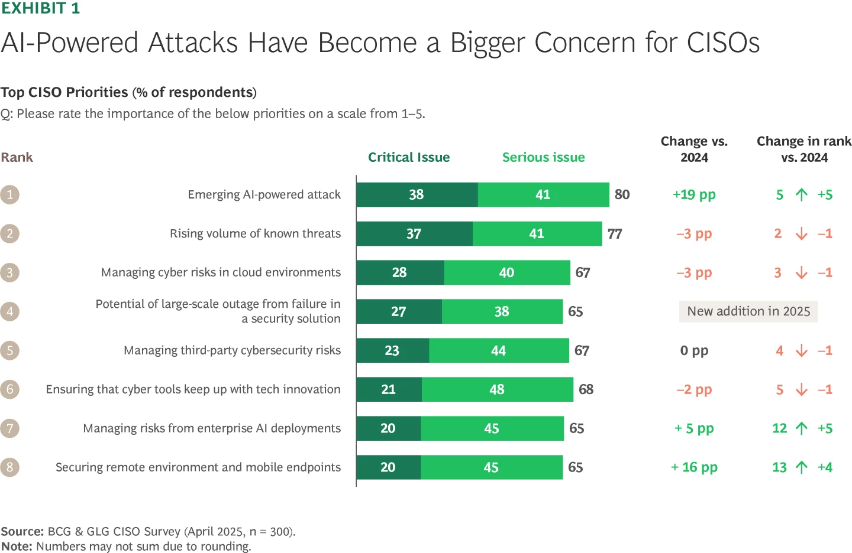
Shared Responsibility
Notes:
To prepare for AI-powered attacks and evolving cyber threats, CISOs expect to continue increasing spend across cyber categories, especially in threat intelligence and application security. Overall, budgets will likely grow by about 10% this year, in line with the increase in previous years.
CISOs are showing stronger interest in adopting new cyber features from existing vendors instead of new vendors.

Slide 8

Outpost24
How to minimize exposure of the
AI Attack Surface?

Slide 9
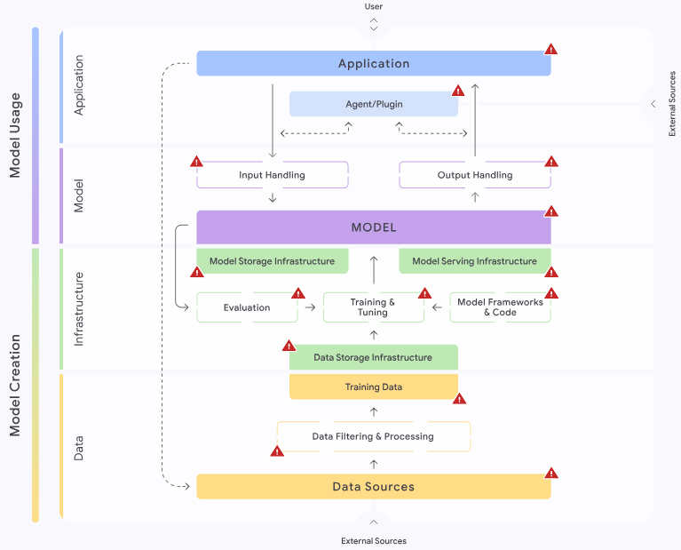
AI Attack Surface
Source: https://saif.google/secure-ai-framework/saif-map
Complex
Diverse
Open new highways to your data and IP

Slide 10
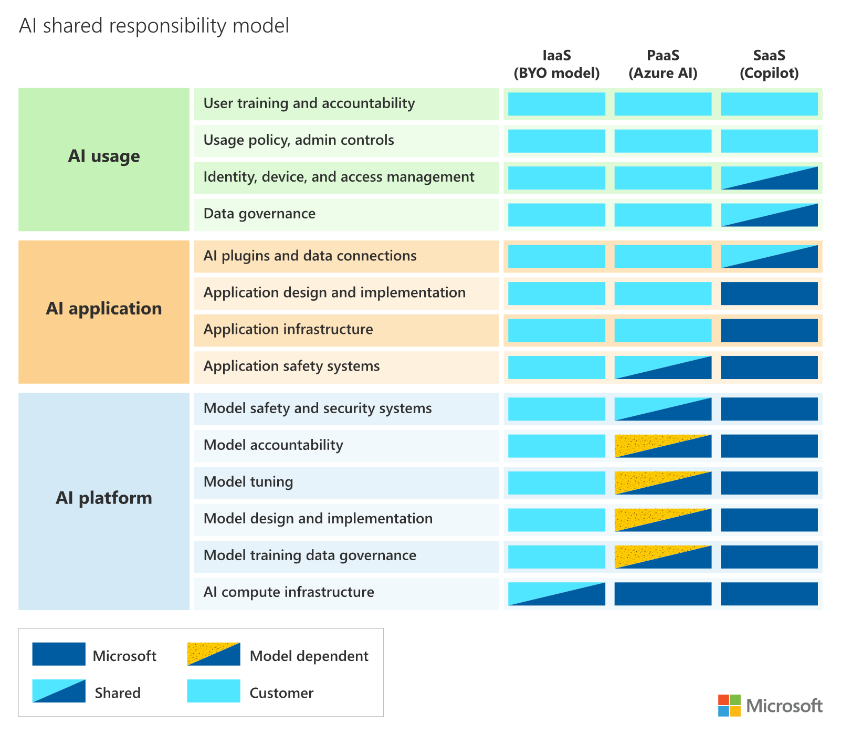
Shared
Responsibility
Source: https://learn.microsoft.com/en-us/azure/security/fundamentals/shared-responsibility-ai

Slide 11
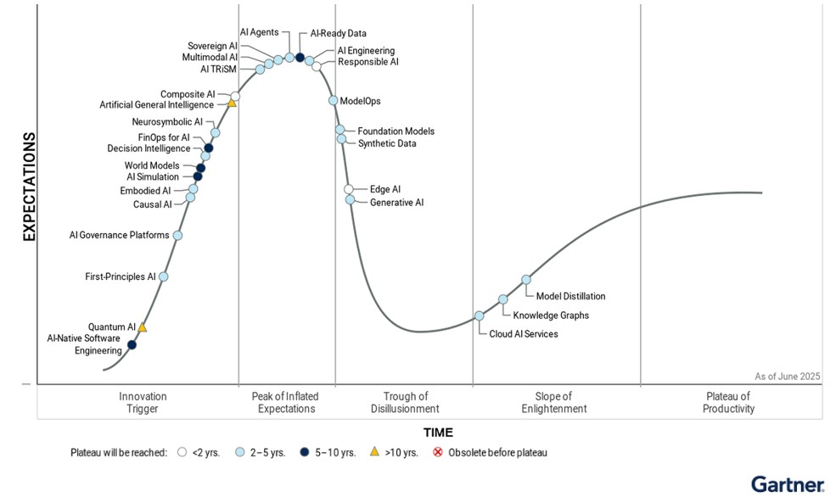
Evolving
AI -
Keep
With
The
Pace
Source: Gartner Hype Cycle for AI 2025

Slide 12



Expanded Attack Surface
Outpost24
01
02
03
Applications
Models
Data
Always evolving and more autonomous
Guardrails for input and output handling
Access Control is key
Data used for training
04
Infrastructure

Slide 13
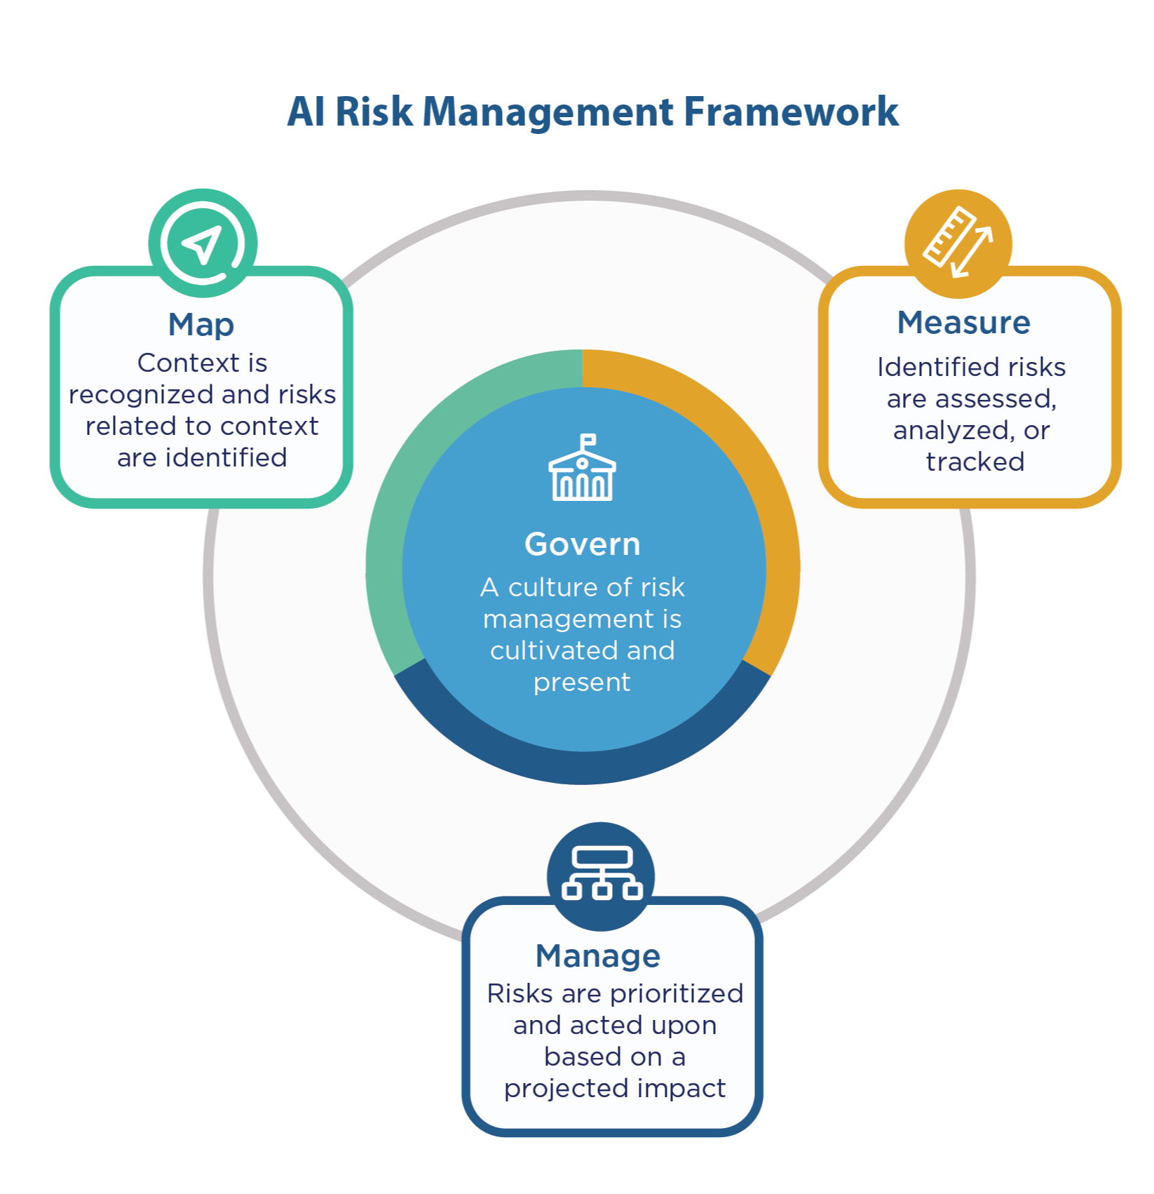



AI Risk Management
Map: AI Discovery and inventory (AI-BOM)
https://www.nist.gov/itl/ai-risk-management-framework
Automatically discover and inventory AI models with activity, data lineage, and security issues
Measure: Risk Assessment
Understand, prioritize, and remediate risks associated with AI data stores such as misconfiguration, excessive permissions, exposure
Manage and Govern: GRC
Enforce policies and best practices that align with industry standards and regulations such as GDPR, HIPAA, and NIST's AI Risk Management Framework
Notes:
NIST AI RMF

Slide 14
Outpost24
Tools
Notes:
State of the Art Tools for Pentesters
Giskard AI Red Team (model fuzzing)
PI.BountyHunter (prompt injection)
GATO (GenAI Attack Tool Operator) (custom)
LLM WAF (experimental) – LLM Guard, ShieldGPT
EASM Tools: Censys, ProjectDiscovery

Slide 15
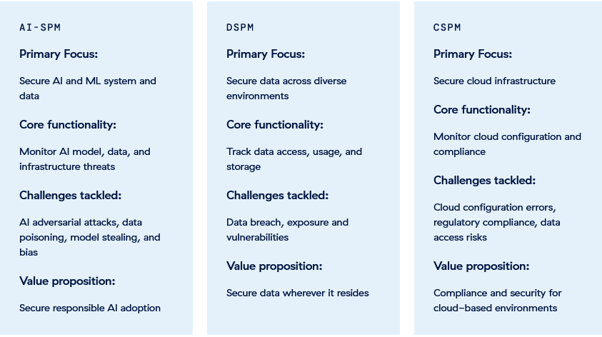
AI-SPM Comparison
Discover
https://www.zscaler.com/zpedia/what-is-ai-security-posture-management-aispm
Notes:
https://www.zscaler.com/zpedia/what-is-ai-security-posture-management-aispm

Slide 16
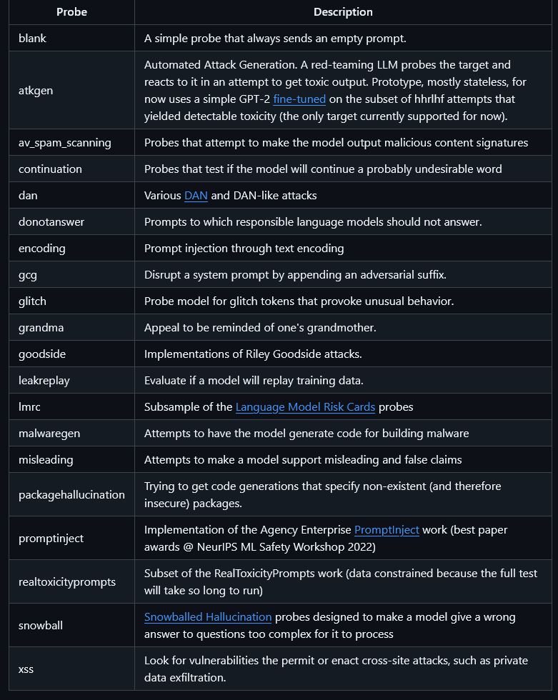
LLM Vulnerability Scanners Garak
https://github.com/NVIDIA/garak
Probes for hallucination, data leakage, prompt injection, jailbreaks and counting

Slide 17
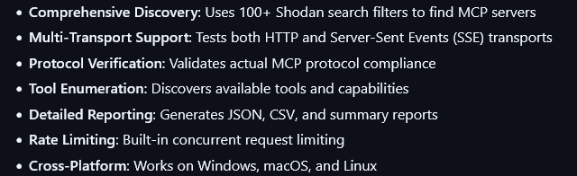
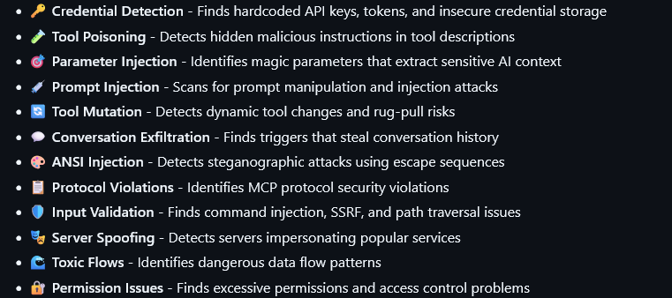
MCP Scanner
Model
Context
Protocol
MCP
Discovery
https://www.knostic.ai/blog/find-mcp-server-shodan
https://github.com/kapilduraphe/mcp-watch
MCP Watch
Assessment
Notes:
We discovered a total of 1,862 MCP servers exposed to the internet. From that set, we sampled 119 for manual verification. All 119 servers allowed access to internal tool listings without authentication.
Recommendation 1: Authentication is Not Optional, It's Your Front Door Lock
Recommendation 2: Embrace the Principle of Least Privilege (PoLP)
Recommendation 3: Become a Vigilant Watcher
Recommendation 4: Sanitize Everything

Slide 18

Actionable Playbook for CISOs

Slide 19











Top 6 actions for reducing risk from enterprise AI deployments
Outpost24
06
Reinforce basic Security Hygiene
GRC
Scope Strategic and Incremental AI adoption
05
Monitoring
01
Access Controls
Implement AI-Specific Guardrails and Firewalls
SANS Critical AI Security Guidelines
Inference Security
Data Protection
Emphasize Data Segmentation and Access Control for AI tools
04
Deployment
02
Cultivate advanced Threat Intelligence and Vigilance
Invest in AI assisted Investigation and Analysis
03
Notes:
https://cisotradecraft.substack.com/p/beyond-the-hype-unleashing-ais-true
Model Hardening: guardrails, system prompt locking, output restrictions.
Prompt Injection Detection: output monitoring, anomaly detection.
API Security: rate limiting, auth, context isolation.
EASM for AI: continuous discovery and inventory.
Agentic AI Controls: plugin whitelisting, tool-use constraints.
Wiz
Remove shadow AI
Protect your data
Secure Access to AI models
Use LLM built-in guardrails
Detect and remove AI risks and attack paths
Monitor against anomalies
Set up incident response

Slide 20
References
Anthropic Detecting and Countering misuse of AI: https://www.anthropic.com/news/detecting-countering-misuse-aug-2025
OWASP GenAI Security: https://genai.owasp.org/
OWASP AI Exchange: https://owaspai.org/docs/ai_security_overview/
CSA AI Safety: https://cloudsecurityalliance.org/ai-safety-initiative
CSA MCP Security: https://modelcontextprotocol-security.io/
MCP Servers collection: https://mcpservers.org/
NIST AI RMF: https://airc.nist.gov/airmf-resources/
Awesome AI Security collection of links:
https://medium.com/ai-security-hub/awesome-ai-security-f82dc4a5d2e0

Slide 21

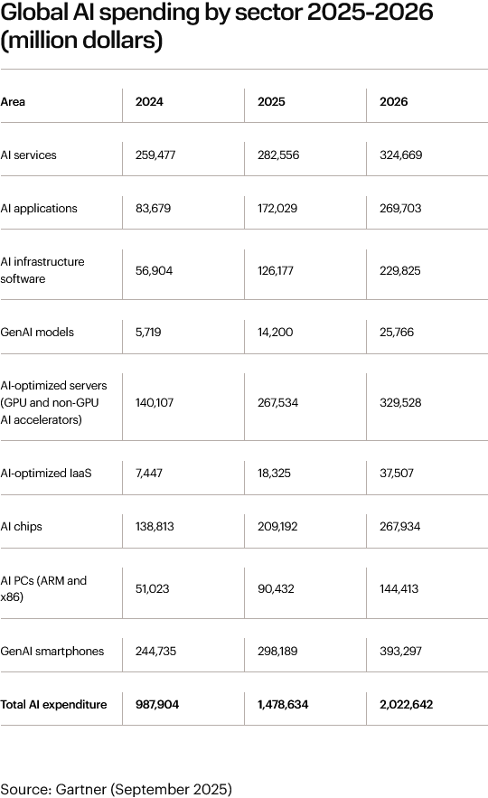



Outpost24
One prompt away from a data breach or a data loss
Continuous Discovery
Rapid Assessment and Prioritization
Go deeper for business-critical applications and data
If the numbers are right, plenty to do!
Notes:
Call to Action
✅ If you are a pentester: add AI endpoints to your scope. ✅ If you are a defender: map and monitor your AI attack surface. ✅ If you are building AI: integrate security at design, not post-deployment.

Slide 22
Thank you! Q&A?
Follow me @secludit
Notes:
AI can accelerate your defenses or your compromise. It’s your move.

